Slide 1


Prashanth B
23rd July 2024

Slide 2

Outline
Executive Summary
Introduction
Methodology
Results
Conclusion
Appendix

Slide 3
Executive Summary
We are going to use Data science methodologies to determine the success of SpaceX Falcon 9 launches. We will first do data collection, wrangling and pre processing. We will be doing some Exploratory Data Analysis to get better insights into our data and create some interactive data visualizations with it. Finally, we will predict the success of a launch using machine learning algorithms.
Using data science techniques we found out about some parameters having an impact on the success of a launch, we used this to create ML models to predict this. In this case, the Decision tree classifier had the best performance and accuracy.

Slide 4
Introduction
SpaceX, the Falcon 9 is a reusable rocket designed to transport payloads into orbit, reducing the cost of space missions with numerous launches since its inception. This project aims to leverage data science methodologies to analyze this rich dataset, providing deeper insights into the factors that influence the success of these launches
In this project, we seek to address several key questions that are critical to understanding and predicting the success of SpaceX Falcon 9 launches. Firstly, what are the most significant factors that determine the success or failure of a launch? We aim to analyze various features such as payload mass, launch site, weather conditions, and booster versions to identify their impact on mission outcomes

Slide 5

Section 1

Slide 6
Methodology
Executive Summary
Data collection methodology:
SpaceX API’s and web scraping techniques are used.
Perform data wrangling
Data is understood and transformed into a pre processed form.
Perform exploratory data analysis (EDA) using visualization and SQL
Perform interactive visual analytics using Folium and Plotly Dash
Perform predictive analysis using classification models
Data is trained and tested on different models and with different hyperparameters to determine the best model.

Slide 7
Data Collection
The data collection process for this project involves utilizing the SpaceX API, a comprehensive and publicly available interface that provides detailed information about SpaceX launches
The API used for data collection was: https://api.spacexdata.com/v4/rockets /.
To collect this data, we first establish a connection to the API endpoint using HTTP requests. By sending GET requests to specific endpoints, we retrieve the relevant datasets in JSON format. These datasets are then parsed and converted into structured formats, such as Pandas Data Frames, for easier manipulation and analysis

Slide 8
Data Collection – SpaceX API
GitHub URL of the completed SpaceX API calls notebook: https://github.com/prashanthb-1999/Data-Science/blob/main/Lab11.ipynb
Retreive details from SpaceX API
Store the information into a Pandas dataframe
Filter the data to only include Falcon 9 launches
Perform relevant data cleaning steps

Slide 9
Data Collection - Scraping
GitHub URL of the completed SpaceX API calls notebook: https://github.com/prashanthb-1999/Data-Science/blob/main/Lab12.ipynb
Get Falcon 9 launch details from wikipedia
Store response in a BeatifulSoup object
Parse object and data to retrieve relevant details
Store data in a dictionary/csv

Slide 10
Data Wrangling
The data wrangling process for the SpaceX Falcon 9 launch data involved several critical steps to ensure the data was clean, accurate, and ready for analysis. The key phases included data cleaning, transformation, and feature engineering, which were crucial for creating a robust dataset suitable for exploratory data analysis and machine learning.
GitHub URL of the completed SpaceX API calls notebook: https://github.com/prashanthb-1999/Data-Science/blob/main/Lab2.ipynb
Perform EDA on data
Calculate relevant metrics – E.g. number of launches per site
Analyze mission and outcome relevance with parameters
Explore the outcomes and structure the data

Slide 11
EDA with Data Visualization
The following charts were plotted: Flight Number vs. Payload Mass, Flight Number vs. Launch Site, Payload Mass vs. Launch Site, Orbit Type vs. Success Rate, Flight Number vs. Orbit Type, Payload Mass vs Orbit Type and Success Rate Yearly Trend
We used scatter plots as we understand the relationship between variables visually.
The bar charts help compare different categories visually.
We also used line charts as we can understand data with respect to time.
GitHub URL of the completed SpaceX API calls notebook: https://github.com/prashanthb-1999/Data-Science/blob/main/LabEDA-Visual.ipynb

Slide 12
EDA with SQL
The following SQL queries were performed: GitHub URL of the completed SpaceX API calls notebook: https://github.com/prashanthb-1999/Data-Science/blob/main/LabEDA-SQL.ipynb
• Displaying the names of the unique launch sites in the space mission
• Displaying 5 records where launch sites begin with the string ‘CCA’
• Displaying the total payload mass carried by boosters launched by NASA (CRS)
• Displaying average payload mass carried by booster version F
• Listing the date when the first successful landing outcome in ground pad was achieved
• Listing the names of the boosters which have success in drone ship and have payload mass greater than 4000 but less than 6000
• Listing the total number of successful and failure mission outcomes
• Listing the names of the booster versions which have carried the maximum payload mass
• Listing the failed landing outcomes in drone ship, their booster versions and launch site names for the months in year

Slide 13
Build an Interactive Map with Folium
Markers of all Launch Sites: Added a marker with a circle, popup label, and text label for NASA Johnson Space Center using its coordinates as a start location. Placed markers with circles, popup labels, and text labels for all launch sites to show their geographical locations and proximity to the equator and coasts.
Coloured Markers for Launch Outcomes: Added colored markers for success (green) and failure (red) launches using Marker Cluster to identify launch sites with higher success rates.
Distances from Launch Sites: Added colored lines to show distances from Launch Site KSC LC-39A to nearby points of interest, such as railway, highway, coastline, and the closest city.
GitHub URL of the completed SpaceX API calls notebook: https://github.com/prashanthb-1999/Data-Science/blob/main/Labfolium.ipynb

Slide 14
Build a Dashboard with Plotly Dash
Launch Sites Dropdown List: Added a dropdown list for selecting a launch siteExplain why you added those plots and interactions
Pie Chart for Successful Launches: Added a pie chart to display the total count of successful launches across all sites, and the success vs. failure counts for a specific site when selected.
Payload Mass Range Slider: Added a slider to select a range of payload mass.
Scatter Chart of Payload Mass vs. Success Rate: Added a scatter chart to show the correlation between payload mass and success rate for different booster versions.
GitHub URL of the completed SpaceX API calls notebook: https://github.com/prashanthb-1999/Data-Science/blob/main/spacex_dash_app.py

Slide 15
Predictive Analysis (Classification)
To build the classification model for predicting SpaceX Falcon 9 launch success, we first prepared the data through cleaning, handling missing values, and encoding categorical variables. Key features were then selected based on their relevance. We trained multiple models, including logistic regression, decision trees, SVM, KNN etc. evaluating their performance and accuracy. After hyperparameter, we identified the decision tree classifier as the best-performing model, achieving the highest accuracy predicting launch outcomes.
GitHub URL of the completed SpaceX API calls notebook: https://github.com/prashanthb-1999/Data-Science/blob/main/LabML.ipynb
Standardize and normalize data
Split data into train, val and test
Create GridSearchCV object for hyperparameter tuning
Create ML models and apply GridSearchCV to determine optimal hyperparameters
Calculate accuracy , plot confusion matrix and determine best model

Slide 16

Section 2

Slide 17
Results
Exploratory data analysis results
Interactive analytics demo in screenshots
Predictive analysis results

Slide 18
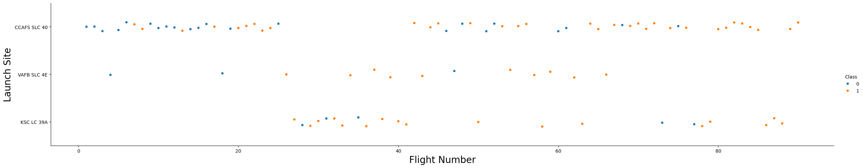
Flight Number vs Launch Site

Slide 19
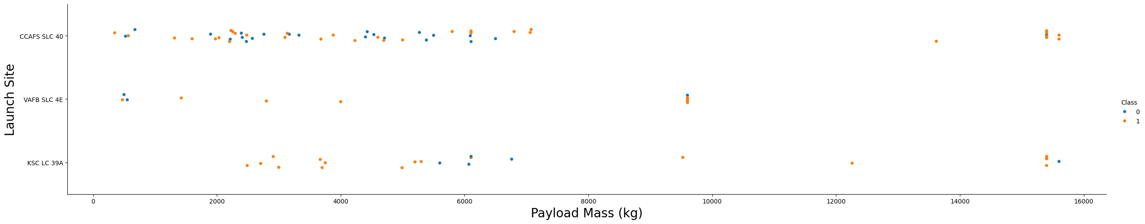
Payload vs. Launch Site

Slide 20
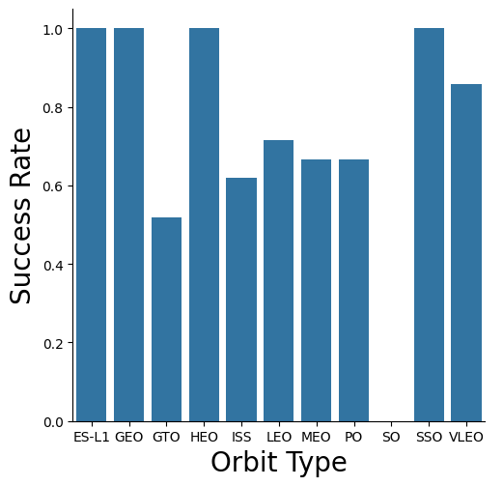
Success rate vs. Orbit type

Slide 21
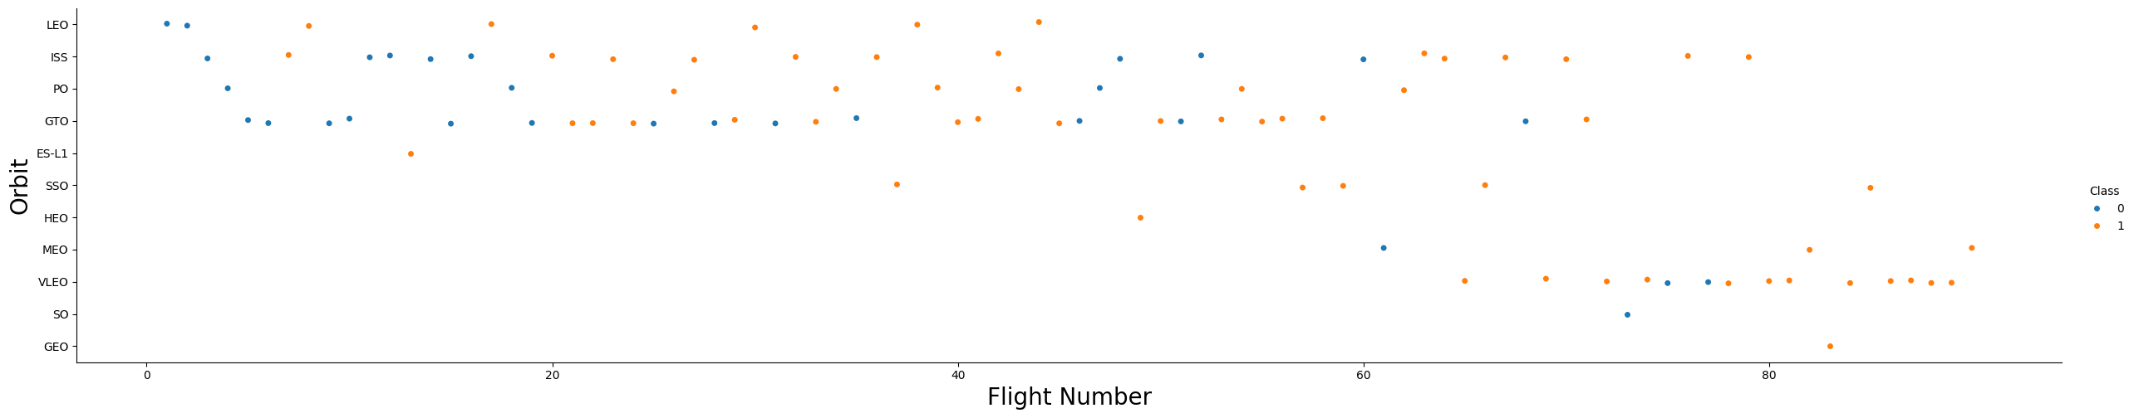
Flight Number vs. Orbit type

Slide 22
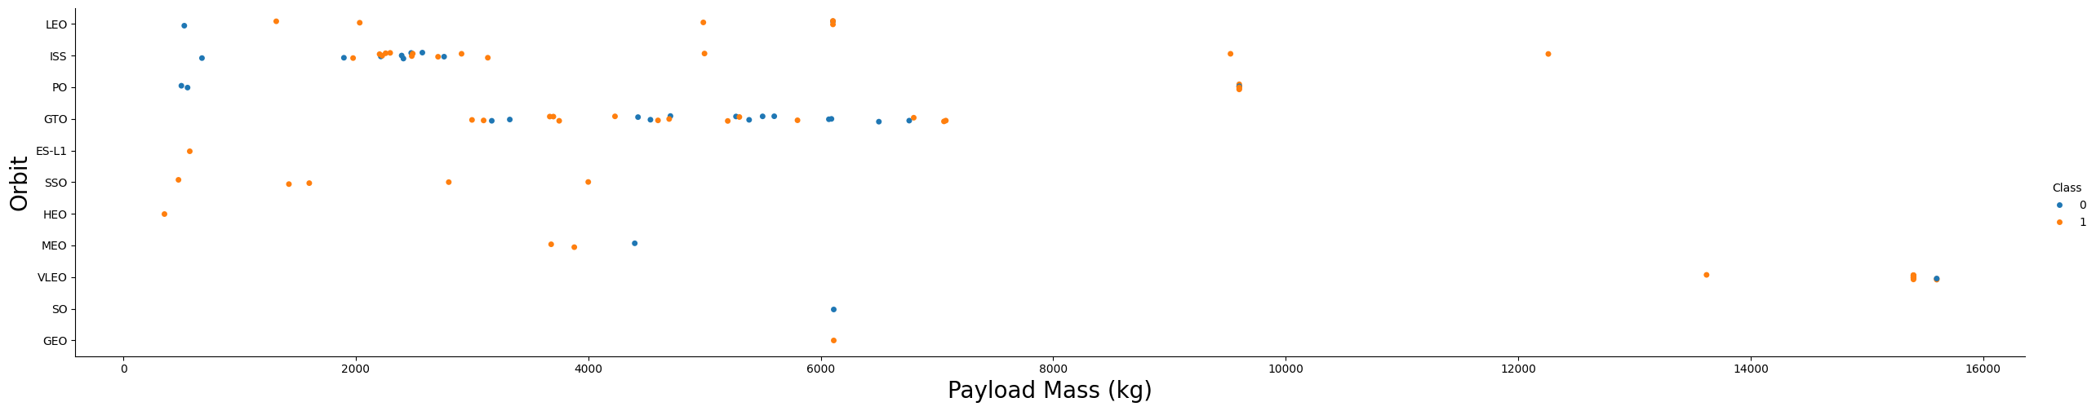
Payload Mass vs. Orbit type

Slide 23
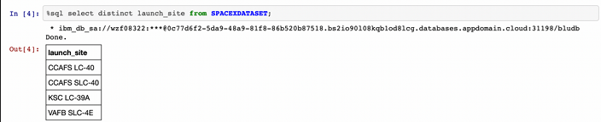
SQL – get launch site names

Slide 24
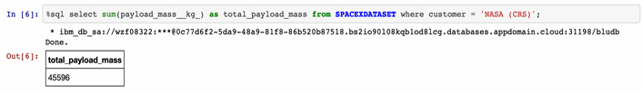
SQL – Total payload mass

Slide 25
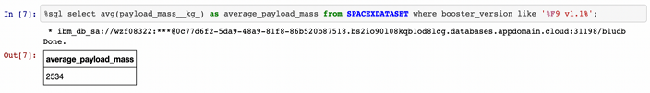
SQL – Avg payload mass by F9 v1.1

Slide 26
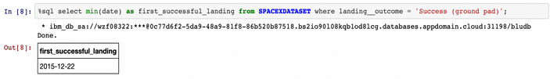
SQL – First successful ground landing

Slide 27
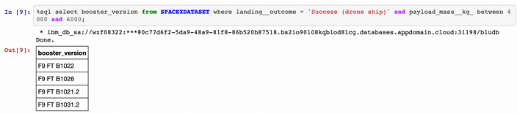
SQL – successful landing based on payload range

Slide 28
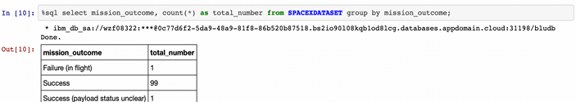
SQL – count of outcomes

Slide 29
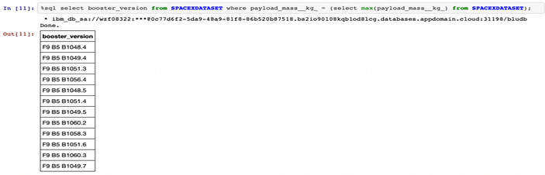
SQL – boosters payload

Slide 30
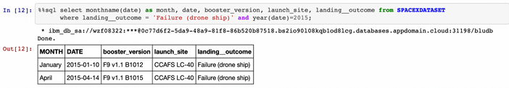
SQL – launches in 2015

Slide 31
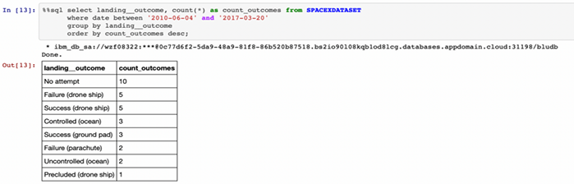
SQL – outcome counts

Slide 32

Section 3

Slide 33
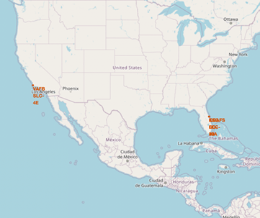
Location of all launch sites
Most launch sites are near the Equator, where the Earth's rotation is fastest. This rotational speed, due to inertia, helps spacecraft achieve the necessary velocity to stay in orbit when launched.
Additionally, all launch sites are close to the coast, allowing rockets to be launched over the ocean, minimizing the risk of debris falling near populated areas.

Slide 34
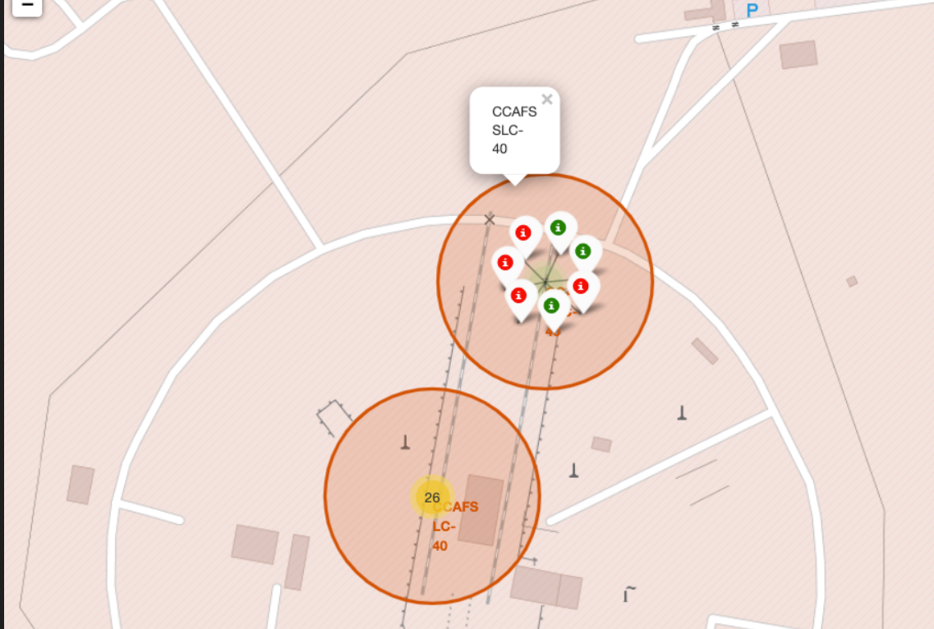
Launch outcomes visualization on map
The color-coded markers allow us to quickly identify launch sites with higher success rates.
Here, a green marker signifies a successful launch whereas a red marker signifies a failed launch.

Slide 35
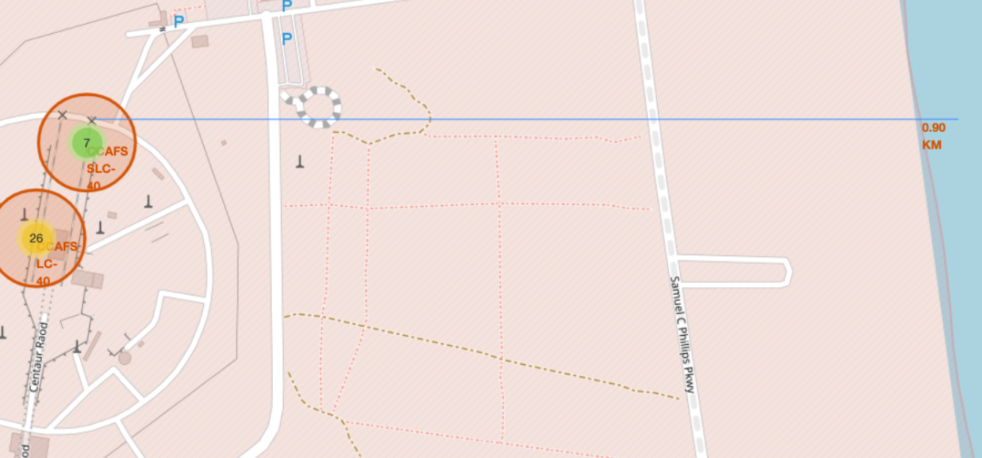
Proximities of a launch site
The map depicts the various proximities to the launch site for an easy understanding
In the given screenshot, we see that the ocean is 0.9km from the launch site.

Slide 36

Section 4

Slide 37
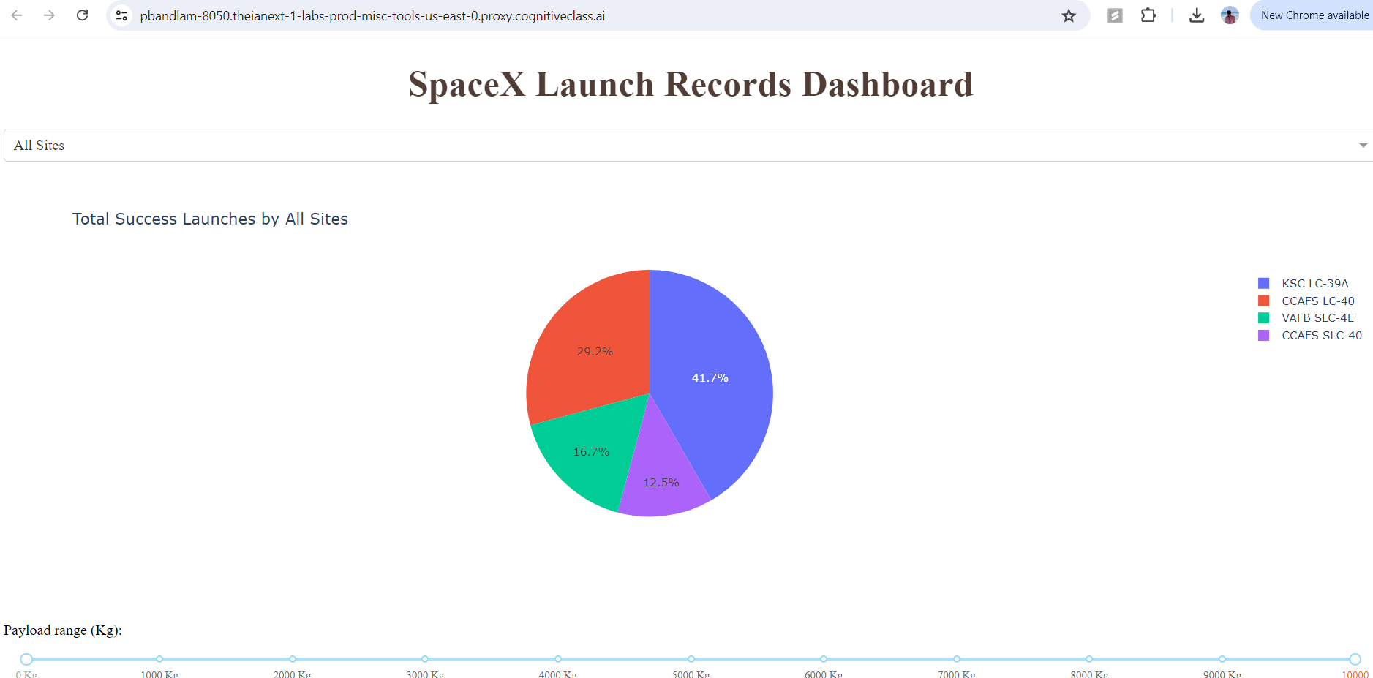
Launch success count
We see in the pie chart the counts of successful launches for each site.
We can derive that the KSC LC-39A launch site has the most successful launches so far.

Slide 38
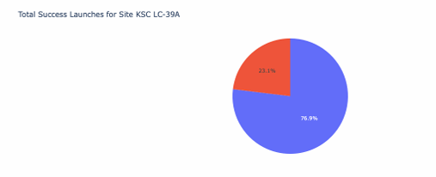
Launch site with highest success ratio
In the pie chart, we can see that the site has a success rate of 76.9%.

Slide 39
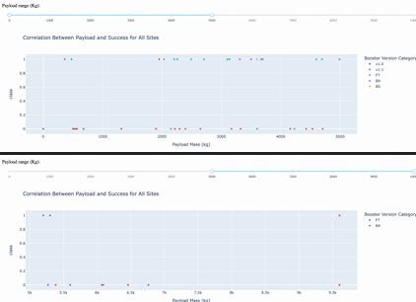
Payload Mass vs Launch Outcome
In the scatter plot, we can visualize the relation between the payload mass and launch outcome.

Slide 40

Section 5

Slide 41
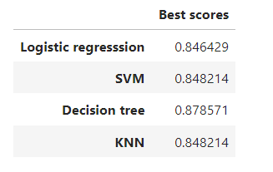
Classification Accuracy
We see that although all models have performed relatively well, the decision tree classifier has outperformed the remaining models.

Slide 42
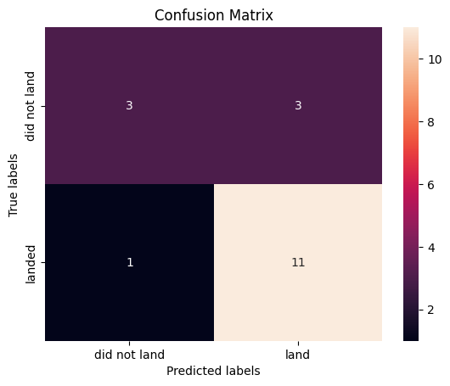
Confusion Matrix
We can see the Confusion matrix of the Decision tree classifier which has a total of 14 correct predictions out of 18.

Slide 43
Conclusions
From EDA we found that low payload mass show higher chance of success of launch.
Using the maps, we found out that most launch sites are nearby equator and also closer to coast line.
The KSC LC-39A has the highest success rate for Falcon 9 launch.
The Decision Tree model is the best model for this project and can be used for launch outcome prediction
Launch success rates have increased with time thanks to advancing technologies.

Slide 44
Appendix
Include any relevant assets like Python code snippets, SQL queries, charts, Notebook outputs, or data sets that you may have created during this project

Slide 45


